Slide 1
Note to students: These slides have not been updated
Using Genre to Understand Self Introductions
A brief lesson on genre
Self introductions (again)
Genre analysis of self introductions
LinkedIn (if time)
Thursday, Jan 23
ENGI 501

Slide 2
Review: rhetorical situation and user-centered design
What are the 6 major components of the rhetorical situation/triangle
How can we use the rhetorical situation to analyze communication situations and understand user’s needs?
New Concept: Genre
“Genre” helps us think about how texts are categorized and recognized as particular kinds of text.

Slide 3
A BRIEF LESSON ON GENRE*
*Adapted from Dr. Anne-Marie Womack
Notes:
Genre’s can be so helpful in developing our knowledge about communication

Slide 4


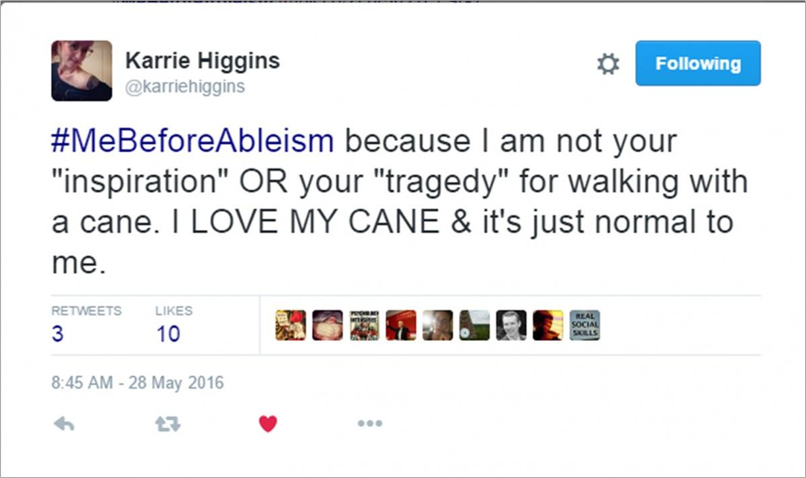
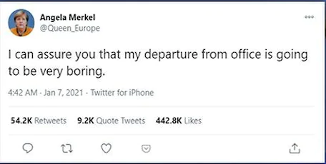
What kind of texts are these? Name the type if you can..

Slide 5
We relied on our own implicit “genre knowledge” to identify them…
How did we know what each of these were?
Wedding Invite Advertisement Tweets
Notes:
We relied on our own implicit “genre knowledge” to identify them because we’ve seen these genres before, perhaps even created them before. But what happens when we encounter a genre that we’re unfamiliar with, or one that we may recognize but have never had to create before?

Slide 6
Genre: A distinctive type of communication that is recognizable because it follows specific guidelines (i.e, genre conventions) and has a specific function.
Genre Conventions: the guidelines or “rules” that tell us how to appropriately create or perform a particular type of communication

Slide 7
Example Genre Conventions
Formatting: What does it look like?
Organization: What information goes where?
Content: What is it about?
Tone: How formal or informal are the language and graphics?
Visual design: What images, graphics, colors, and fonts are used?
Mode/medium: Is it spoken, written, visual, print, digital, video?
Timing: When is it appropriate to use it?
Typical audiences: Who reads, hears, or uses it?
Typical authors: Who writes, speaks, or creates it?
Typical purposes: What does it “do?” What task or action does it accomplish?

Slide 8

Common Conventions of Wedding Invite
Names the couple
Indicates locations, dates, and times of an event
Uses fancy script, decorative features, attractive color palettes
Usually a smaller page, (i.e., not 8.5 X 11), printed on card-stock, and sent in the mail.
Sent 6-8 weeks before the wedding to friends/relatives of the couple named in the text
Creates expectation for response from receiver
Notes:
Take a look at these two wedding invitations: What patterns can we observe across the two? They are not exactly the same, but we can identify them both as wedding invitations. Why?

Slide 9
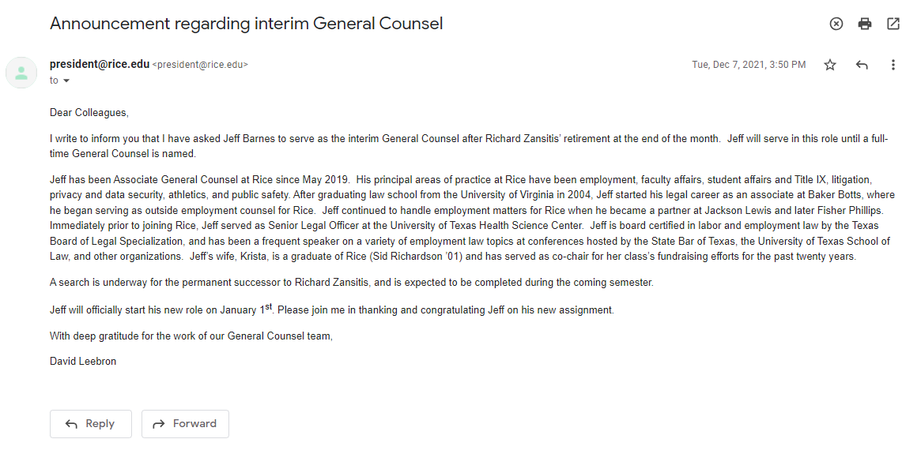

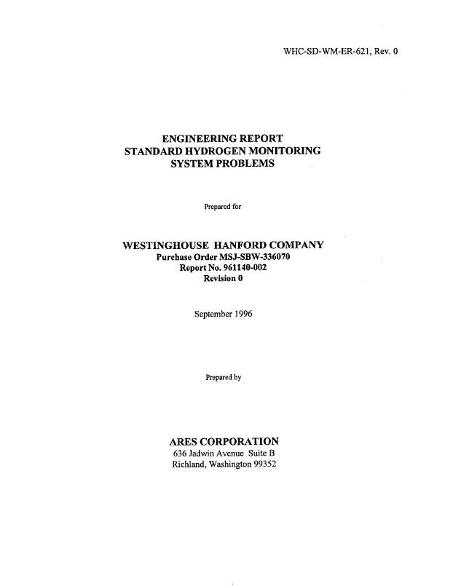
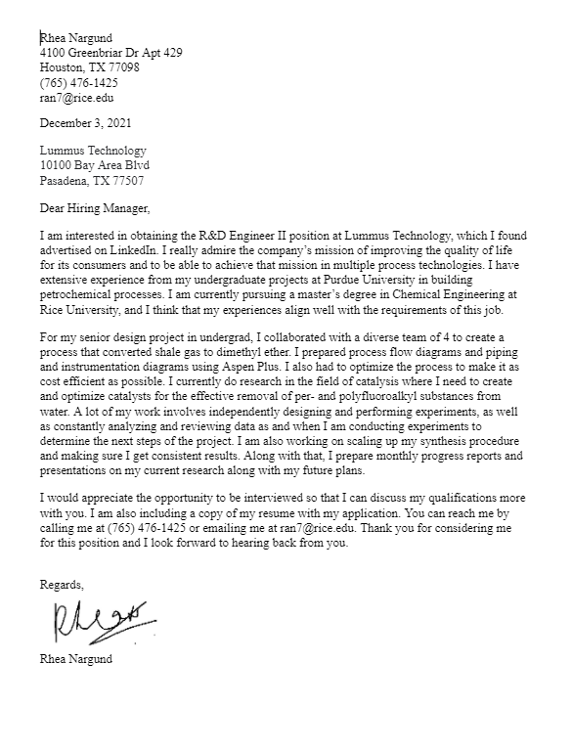
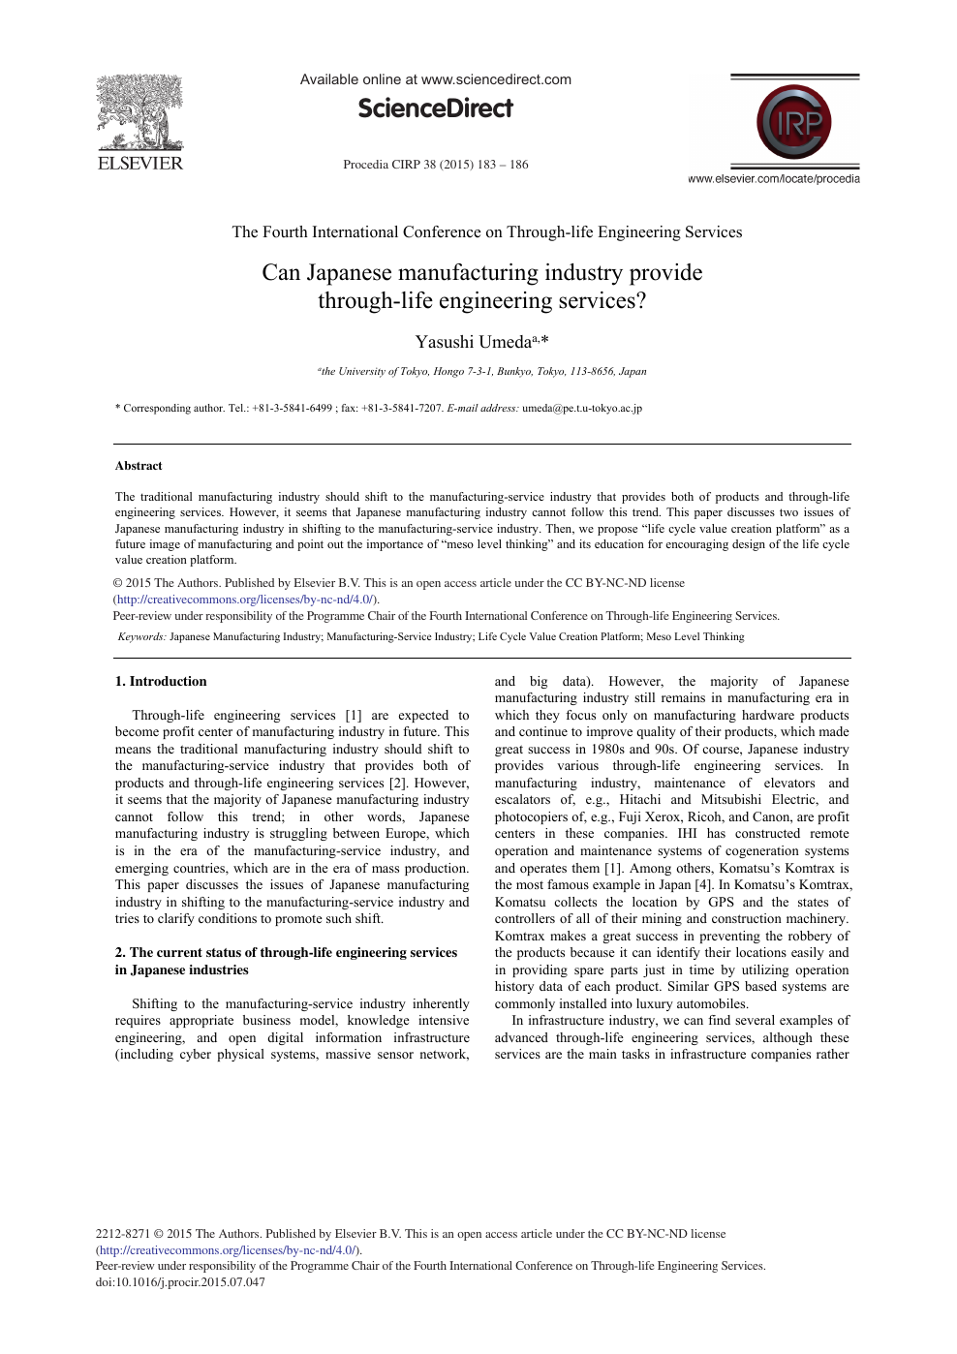

Genres arise in specific domains (e.g., the workplace); genres are used by and created for specific communities (e.g., engineers)
Reports
Emails
Research articles
Cover letters

Slide 10






Genres organize our experiences and coordinate our actions
Notes:
Street, parking, and highway signs are a genre. They help us get where we need to be.

Slide 11





Genres respond to people’s needs and fulfill their purposes
Protests Signs genre conventions:
Convey message concisely
Use dramatic wording
Use humor
Show evocative images
Use Large text/image
Elicit audience response

Slide 12

Genres arise from situations that repeat over and over again
Applying for a job in the US
It takes 21 to 80 job applications to get one job offer, on average.
The average corporate job opening receives roughly 250 applications.
There were 8.2 million job openings on the last business day of June, 2024
5.3 million people were hired in the US, as of June 2024
Notes:
Source for first two bullet points: https://www.zippia.com/advice/how-many-applications-does-it-take-to-get-a-job/
Source for second two bullet points: https://www.bls.gov/news.release/jolts.nr0.htm

Slide 13
Resumes meet the needs and purposes of their authors and audiences
Resumes genre conventions:
Short (1 page maybe 2)
Scannable
Use formal style, tone, and formatting
Incorporate keywords
List skills, experiences, and credentials
Applying for a job in the US
Notes:
Source for first two bullet points: https://www.zippia.com/advice/how-many-applications-does-it-take-to-get-a-job/
Source for second two bullet points: https://www.bls.gov/news.release/jolts.nr0.htm

Slide 14
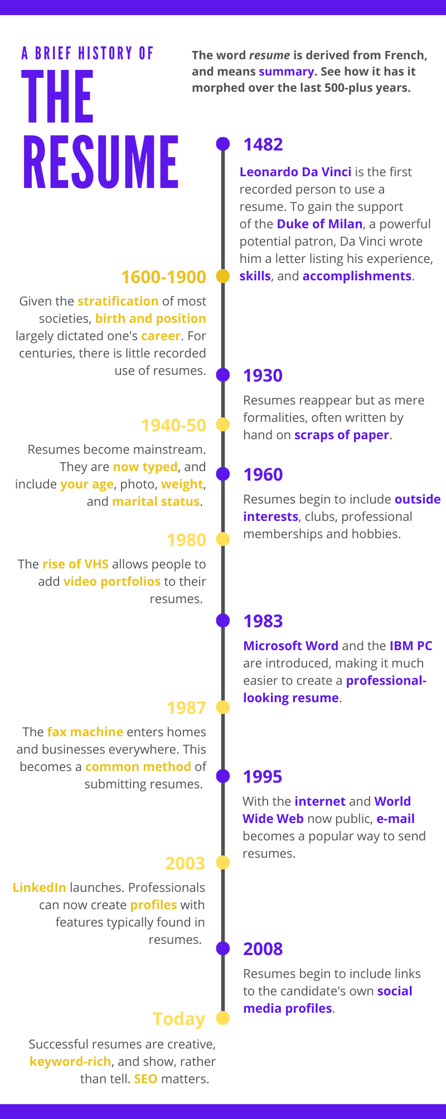
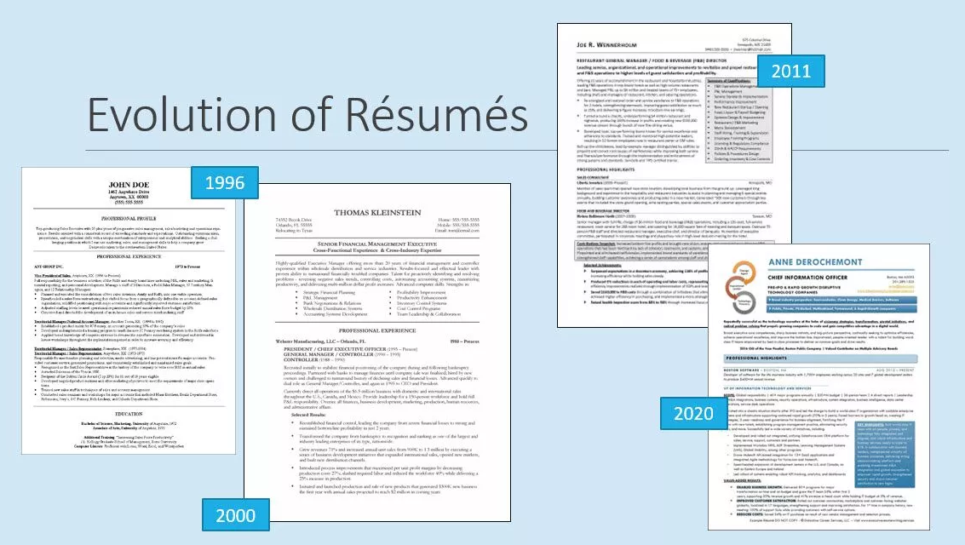
Genres change and evolve as situations change and evolve

Slide 15

Genres reflect the values of the communities who use them
Resumes and Cover Letters
Short (1 page)
Scannable (by human an AI audiences)
Special formatting and style
Specific content (e.g. keywords)
List skills, experiences, education
Notes:
Source for first two bullet points: https://www.zippia.com/advice/how-many-applications-does-it-take-to-get-a-job/
Source for second two bullet points: https://www.bls.gov/news.release/jolts.nr0.htm

Slide 16
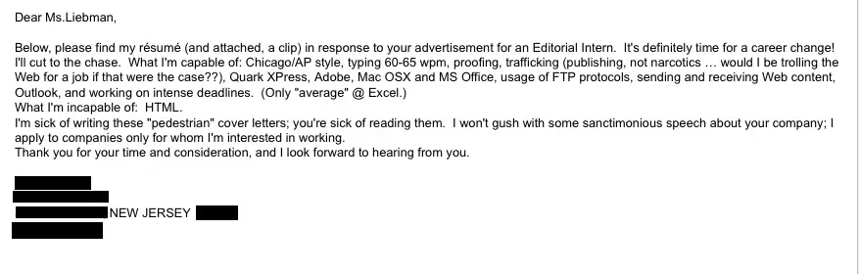
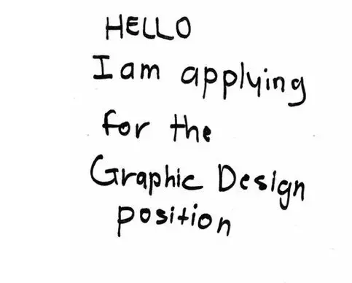
Using a genre (well) signals you belong to a community (or not…)
This cover letter was actually submitted to Business Insider.

Slide 17
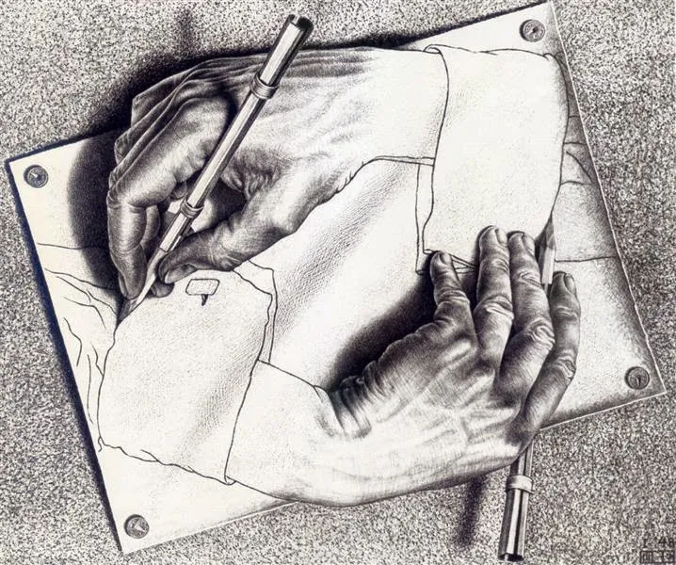
There is a paradox at the heart of all genres
Genres are consistent forms (we know them when we see them) | AND | Genres are flexible forms (we adapt them to our purposes).

Slide 18
There is a paradox at the heart of all genres
Genres are consistent forms (we know them when we see them) A genre displays recognizable similarities | AND | Genres are flexible forms (we adapt them to our purposes). No two instances of a genre are identical

Slide 19
There is a paradox at the heart of all genres
Genres are consistent forms (we know them when we see them) A genre displays recognizable similarities Authors follow genre “rules” to meet audience expectations | AND | Genres are flexible forms (we adapt them to our purposes). No two instances of a genre are identical Authors take liberties and break the “rules.”

Slide 20
Activity
What is the “Self-Introduction” Genre?
What does the genre include? What differences and similarities do you observe across instances of the genre?
Who uses the genre?
What is the genre for?
Notes:
Questions to ask when you’re learning a new genre: What is it? What does it include? Who uses it? What is it for?

Slide 21
Make small groups of 4 - 5 people

Slide 22

“Tell us a little about yourself…”
Imagine today is the first day of a competitive internship at a well-known software engineering company. The members of your small group are your fellow interns. You’re all meeting each other for the first time.
Your team leader starts the meeting by asking everyone to introduce themselves:
Image

Slide 23
Observe your small group:
What did everyone include in their self introduction?
What additional information did some people include but not others?
What information did people put at the beginning? Middle? End?
Did people stand or sit?
How did they use their hands? What did they do with their eyes?
What volume and pace did people speak at?
Notes:
Image: https://ageofthrivability.com/files/2019/01/1yzgJ-66YvsokIvqw93jiJQ.png

Slide 24
How do we introduce ourselves?
What information did everyone include in their self introduction?
Name
Background
What additional information did some people include but not others?
Connection?
Other information?
Conclusion?
Notes:
Image: https://ageofthrivability.com/files/2019/01/1yzgJ-66YvsokIvqw93jiJQ.png

Slide 25
What information did people put at the beginning?
Name
Education
Middle?
End?
Place of origin
Interests
Projects
Family
Hobbies
Other?
Forward-looking statement (“I can’t wait to work with you”)
Compliment (“I’m so thrilled to be working with such a talented group of people”)
Other?
Notes:
Image: https://ageofthrivability.com/files/2019/01/1yzgJ-66YvsokIvqw93jiJQ.png

Slide 26

Did people stand or sit?
Notes:
Image: https://www.google.com/url?sa=i&url=https%3A%2F%2Fspeakerdynamics.com%2Fshould-i-sit-or-should-i-stand%2F&psig=AOvVaw183tG2zSegT-nqu_Shn4V-&ust=1725391694239000&source=images&cd=vfe&opi=89978449&ved=0CBQQjRxqFwoTCKiE_Yr_pIgDFQAAAAAdAAAAABAQ

Slide 27


How did people use their hands and gestures?
What people do with their eyes and facial expressions?
Notes:
Image (left): https://www.theladders.com/career-advice/a-celebrity-body-language-expert-said-these-are-the-7-things-you-must-know
Image (right): https://brandastic.com/blog/why-eye-contact-is-important/

Slide 28

What volume and pace did people speak at?
What other aspect of voice were similar or different (intonation, emphasis, pauses?
Notes:
Image: https://ageofthrivability.com/files/2019/01/1yzgJ-66YvsokIvqw93jiJQ.png

Slide 29
Self Introductions as a Genre
Who uses the genre?
What is the genre for?
What does the genre include? What differences and similarities do you observe across instances of the genre?

Slide 30
Genre: What you need to know
Whenever you’re facing an unfamiliar type of communication, try to find 2-3 examples of it and then answer these questions:
What is it?
Who uses it?
What’s it used for?
What does it include? What differences and similarities exist across different instances?

Slide 31
What to prepare for next class:
Bring to Class: A HARD COPY of your resume (where to print at Fondren Library); OR I can print it for you if you email it to me before class (mg158@rice.edu)
Review before class today
Project 1 Instructions (coming soon)
“Document Design” (~20 pages from Markel and Selber, lots of images)

Slide 32
LinkedIn (if time) https://docs.google.com/presentation/d/1BIEnChWnKjZ2mtqgXtGp7rtWCfhhYlp93BP9X_txgw4/edit?usp=sharing

